Slide 1

User Manual of Hemant Bookshop Management
Table of Contents
1.Login process
2.How to create record
3.How to search record
4.How to delete record
5.How to exit application

Slide 2
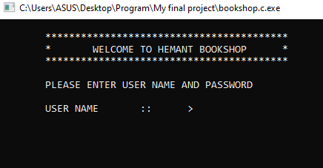
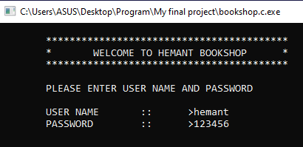
1.Login process
➤Enter the username and password.
➤Entered username and password should be user name - hemant and password -123456.
➤If username and password matches then only we can enter in the program.

Slide 3
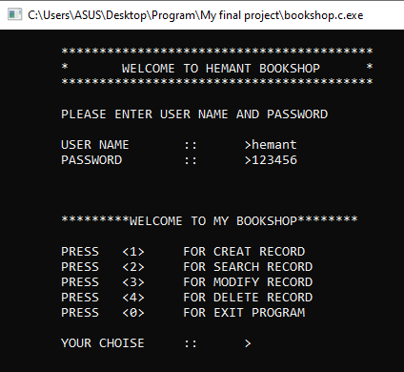
2.How to create record
➤ If we want to create record of book then enter choice as <1> and fill the information.

Slide 4
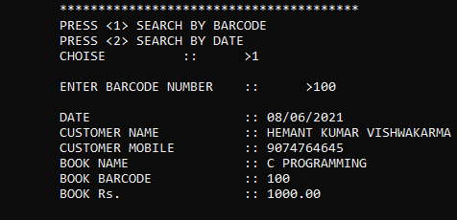
➤ If we want to create more record we can do that by presssing “y” key otherwise press “n” key.
➤ The information we have given will be stored when we press “n”, and then it will display us the message saying “data record success”.

Slide 5
2.How to search record
➤ If we want to search record of book then enter choice as <2>. After that we will get two option to choose from, Search by date and search by barcode.
➤ If we want to search by barcode then press <1> and enter the barcode number which will then display the Information.

Slide 6
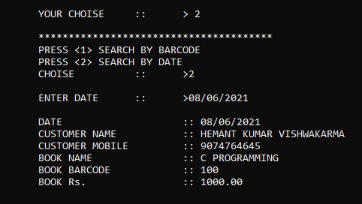
➤ If we want to search by date then press <2>. After that enter the date and it will display the information.

Slide 7
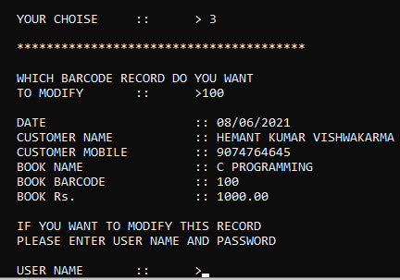
3.How to modify record
➤ If we want to modify record of book then enter choice as <3> and we’ll get an option to modify information by entering barcode. After entering barcode it will display the records.
➤ After that we need to enter username and password. If Username and password matches to user name - hemant and password -123456, only then we are able to modify record.

Slide 8
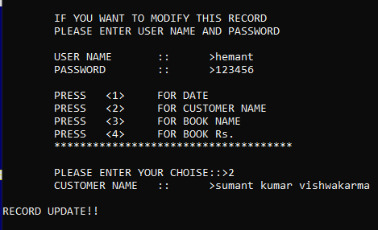
➤ Press <1> to modify date.
➤ Press <2> to modify customer name.
➤ Press <3> to modify book name.
➤ Press <4> to modify Rs of the book.
➤ After modifying the Record we get a message saying “RECORD UPDATE!!”.

Slide 9
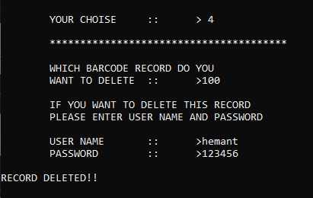
4.How to delete record
➤ If we want to delete record enter choice as <4>. Now we can delete record by entering the barcode and pressing enter key. Then it will ask us to enter user name and password if the username and password matches to the user name - hemant and password -123456, then it will display us the message “RECORD DELETED”.

Slide 10
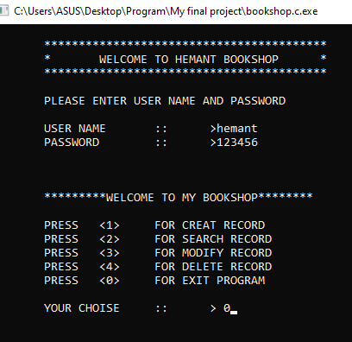
4.How to exit application
➤ If we want to exit from application enter choice as <0> and press enter key..
Thank You

